Slide 1

Salary Prediction using Ensemble Learning
A Machine Learning Approach for Accurate Salary Estimation
Submitted by:
Kushagra Kushwaha
Submitted to:
R Devnath

Slide 2
Introduction
Predicting salaries helps companies and job seekers make informed decisions
Machine learning models can estimate salaries based on skills, experience, and other features
Ensemble learning improves prediction accuracy by combining multiple models

Slide 3

Dataset Details
Features: Experience, Education, Job Role, Industry, Location
Target Variable: Salary (in currency)
Preprocessing:
Missing value handling
Encoding categorical data
Feature scaling
Uses RandomForest Regressor for accurate predictions
Why Ensemble Learning?
Single models may underfit or overfit
Ensemble methods reduce bias & variance
Combine strengths of multiple models for better accuracy

Slide 4

Ensemble Methods Used
Bagging (Random Forest) – Trains multiple models in parallel
Boosting (XGBoost / Gradient Boosting) – Sequentially corrects errors
Stacking – Combines predictions of base models using a meta-model

Slide 5
Libraries and dataflow
📌 1️⃣ Data Handling & Analysis
Pandas - for handling datasets (CSV, Excel, DataFrames)
Numpy – for numerical operations
📌 2️⃣Machine Learning (Model Building)
scikit learn - for regression models, train-test split, evaluation metrics
Xgboost - for Gradient Boosting and XGBoost Regressor
Lightgbm - for faster boosting models
📌 3️⃣ Model Evaluation
Sklearn.matrics – R² score, MAE, RMSE
📌 4️⃣Saving Models
Joblib or pickle – to save and load trained models

Slide 6
Workflow
Data Collection & Preprocessing
Train-Test Split
Train Base Models (Linear Regression, Decision Tree, etc.)
Apply Ensemble Methods (Bagging, Boosting, Stacking)
Evaluate using R², MAE, RMSE

Slide 7

Challenges
❌ Limited dataset size → Risk of overfitting ❌ Feature engineering complexity ❌ Salary data can be biased based on industry/location
Solutions
✅ Used cross-validation for better generalization ✅ Hyperparameter tuning (GridSearchCV / RandomizedSearchCV) ✅ Added relevant features for improved accuracy

Slide 8
Installation & Usage
Steps to Install & Run the Project
1️⃣ Clone the Repository
git clone https://github.com/Kushagrakushwaha/salary-prediction.git cd salary-prediction
2️⃣ Create Virtual Environment & Install Dependencies
pip install -r requirements.txt
3️⃣ Run the Project
python train_job_model.py
4️⃣ Check Predictions – Modify input features in the script or UI (if available)

Slide 9
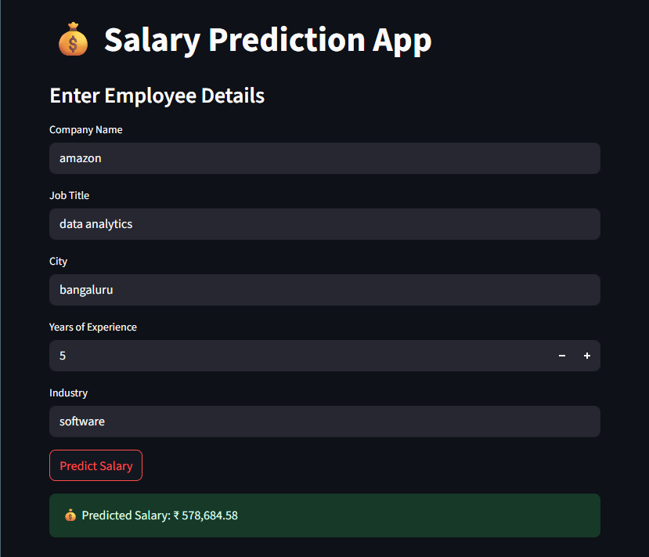
Results
Stacking model performed best with highest R² score
Ensemble models outperformed individual models
Predictions were more stable and accurate

Slide 10

Conclusion
Ensemble learning improved salary prediction accuracy
Stacking gave the best results among all models
Future Scope:
Use larger datasets
Include advanced features like company size, skills, certifications
References
scikit-learn documentation
XGBoost, LightGBM libraries
Kaggle datasets for salary prediction

